Slide 1
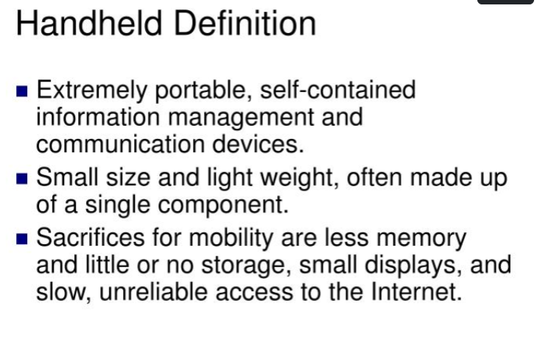

Slide 2
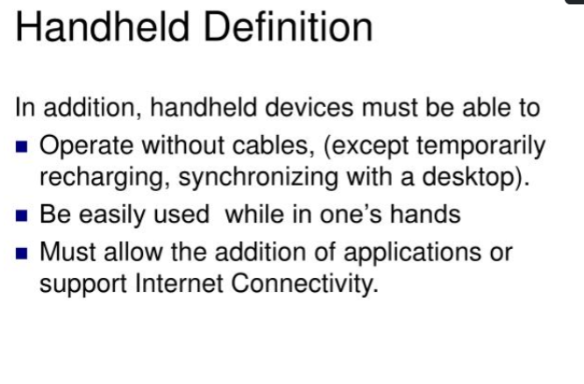

Slide 3
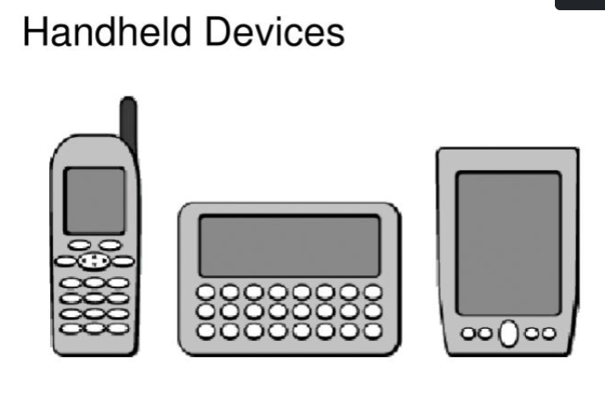

Slide 4
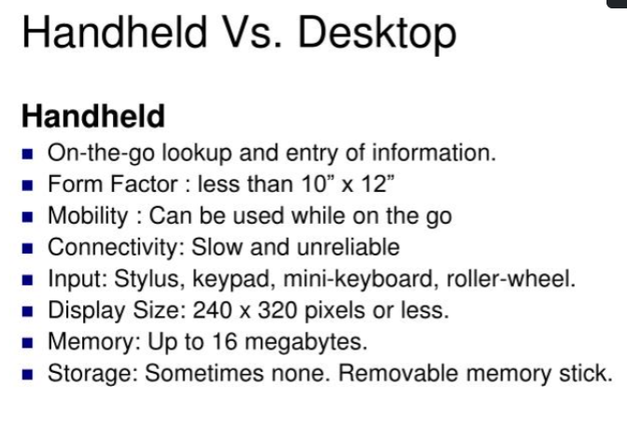

Slide 5
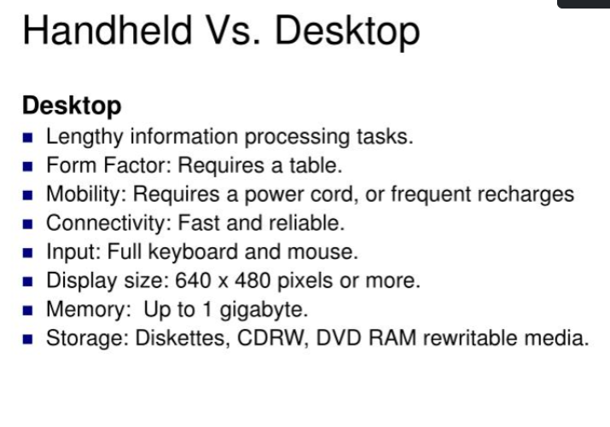

Slide 6
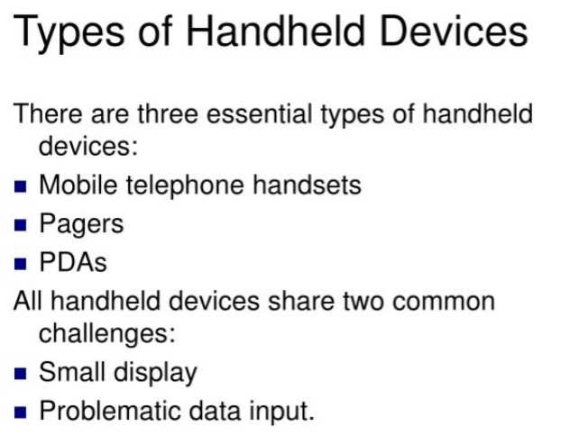

Slide 7
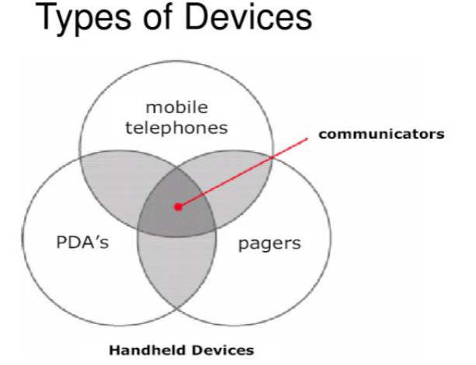

Slide 8
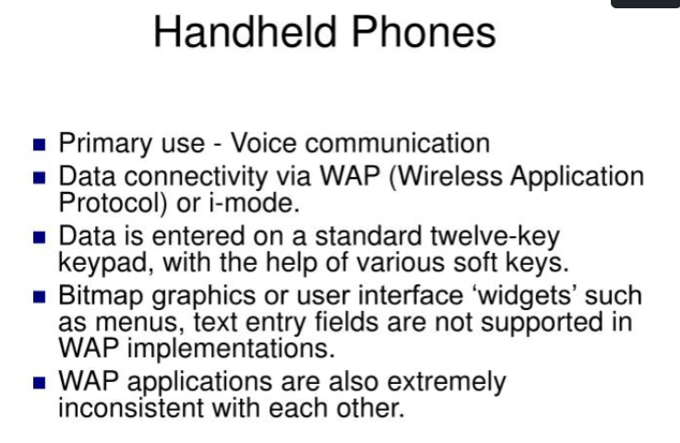

Slide 9
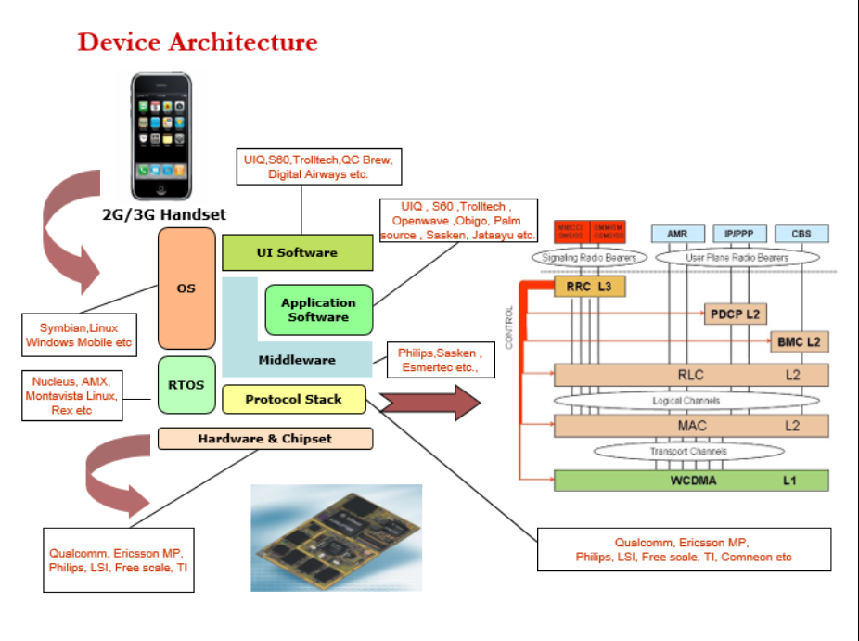

Slide 10
WCDMA- Wideband code division multiple access
MAC-Medium Access Control
RLC - Radio Link Control
BMC - Broadcast/Multicast control
PDCP - Packet Data Convergence Protocol
RRC - Radio Resource Control
AMR - The AMR (Adaptive Multi-Rate) standard is a speech coding algorithm operating at eight-bit rates in the range of 4.75 to 12.2 kbps and was specifically designed to improve link robustness.
PPP – Point to Point Protocol

Slide 11
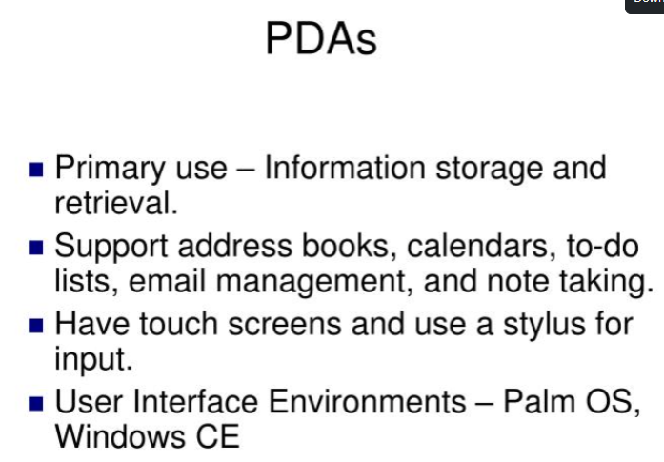

Slide 12
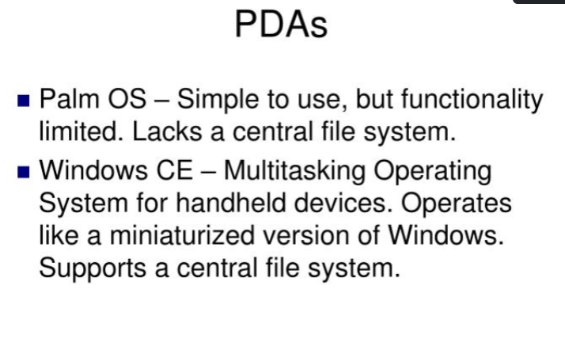

Slide 13
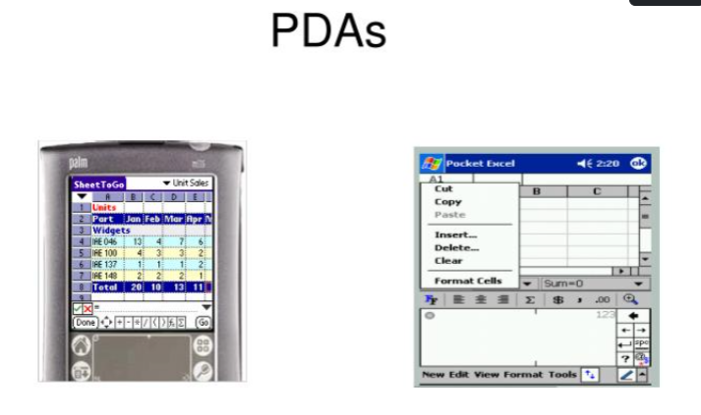

Slide 14
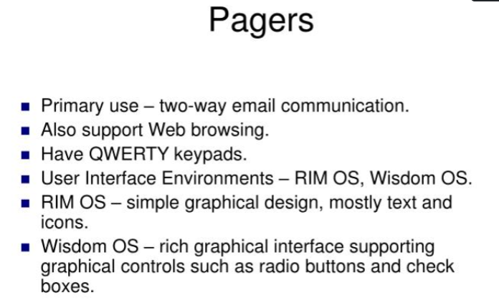

Slide 15
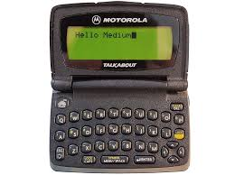
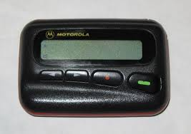

Slide 16
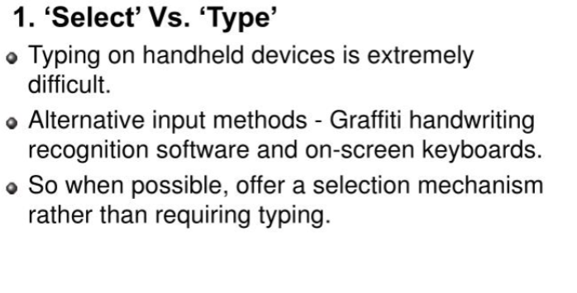
User Interface Design Guidlines for Handheld Devices

Slide 17
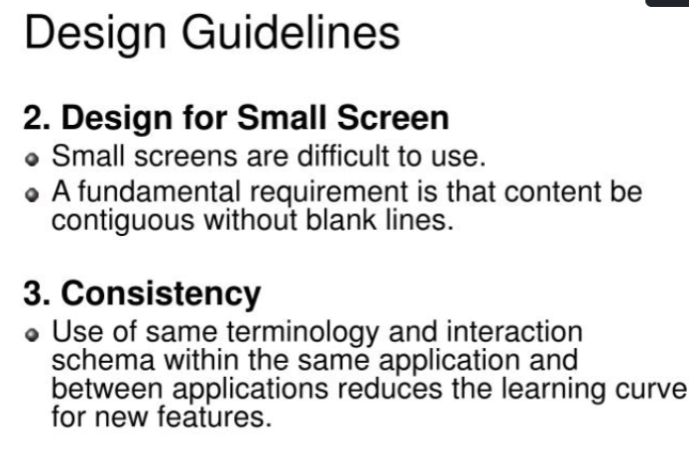

Slide 18
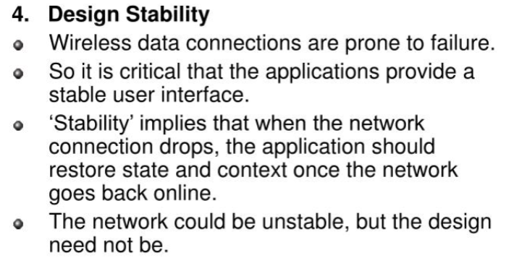

Slide 19
